Slide 1

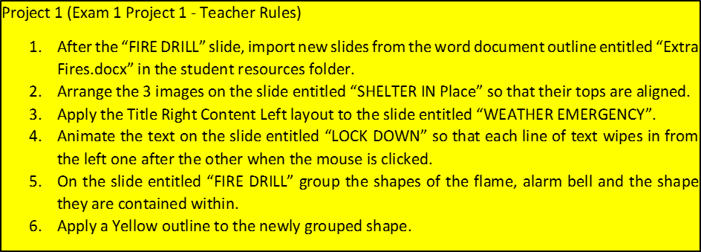
Welcome to Room 101
CLASS Procedures
World’s Best Teacher
Notes:
Task 1 – Apply a Fade Transition with a duration of 3 seconds to all of the slides in the presentation

Slide 2


BATHROOM
BREAKS
Do not say the b-word
Sign out (3 sign outs per marking period)
Use the pass
Bring it back
1
2
3
4

Slide 3


FIRE DRILL
1
Push chairs in
Lights out
Single file, silent line
Proceed toward the woods
Pass the playground on the right
Count off
2
3
4
5
6

Slide 4

EVACUATION
Push chairs in
Lights out
Single file, silent line
Walk toward the high school
Pass the playground on the left
Proceed to new gym
Count off
1
2
3
4
5
6
7

Slide 5



SHELTER IN PLACE
1
2
3
Door closed
and locked
Windows covered, closed, and locked
Students may only move around the building
escorted by an adult

Slide 6


LOCK DOWN
Lights out
Door locked
Hide under the tables
Chair pulled toward you
No talking
1
2
3
4
5

Slide 7


WEATHER EMERGENCY
1
2
Know the safety zone
Move quickly and quietly to the safety zone

